Slide 1

A Day at the Vets
Notes:
Presenter Notes:
Please feel free to change the title

Slide 2
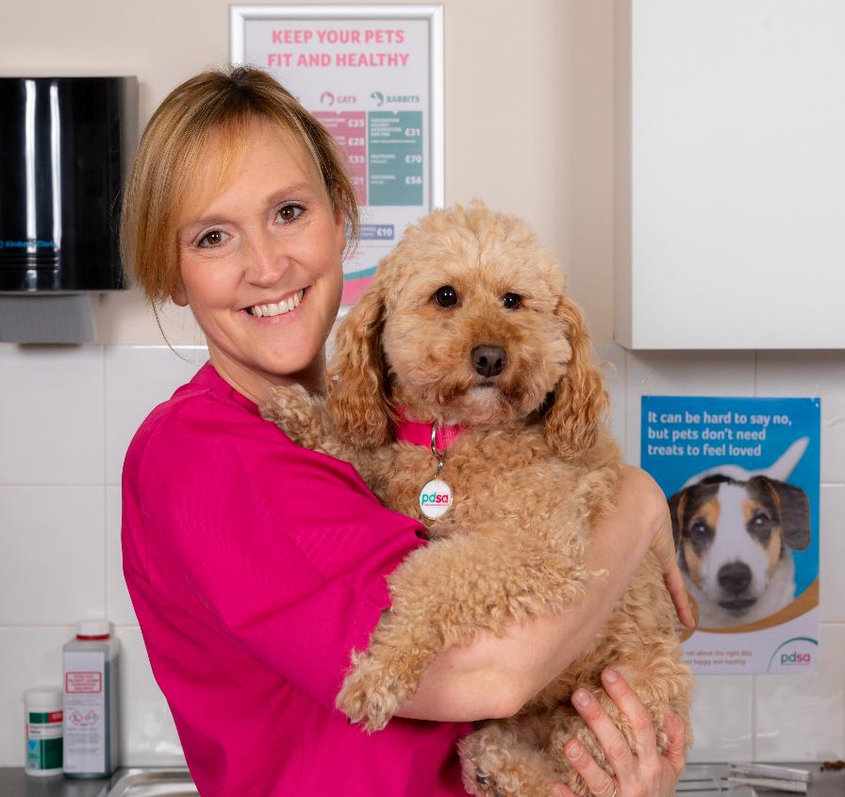
Nina
About me!
My role:
What I do:
Fact about me:
Vet Nurse
Preparing animals for treatment, helping the vet with procedures, administering medication, etc…
I have a cat named Strawberry
Notes:
Presenter Notes:
Replace the image with an image of the vet/vet nurse presenting
Replace the name of the vet/vet nurse presenting (you may just want to use your first name)
Complete key information in the ‘about me’ section in relation to the vet/vet nurse presenting
Replacing the picture:
Double click on the circle including the image so it selects the image circle only
Right click on the image
Scroll down and select ‘Format Picture’
Select ‘Fill’ (i.e., pain can’) icon
Select ‘Picture or texture fill’
Next click on ‘insert’ box
Select ‘From a file’ from the pop up box
Select the image of your choice
Note: If the image is distorted and you need to readjust, in the ‘Format Background’ tool bar on the right, scroll down and adjust the ‘offset left’, ‘offset right’, ‘offset top’ and ‘offset bottom’ percentages where needed.

Slide 3
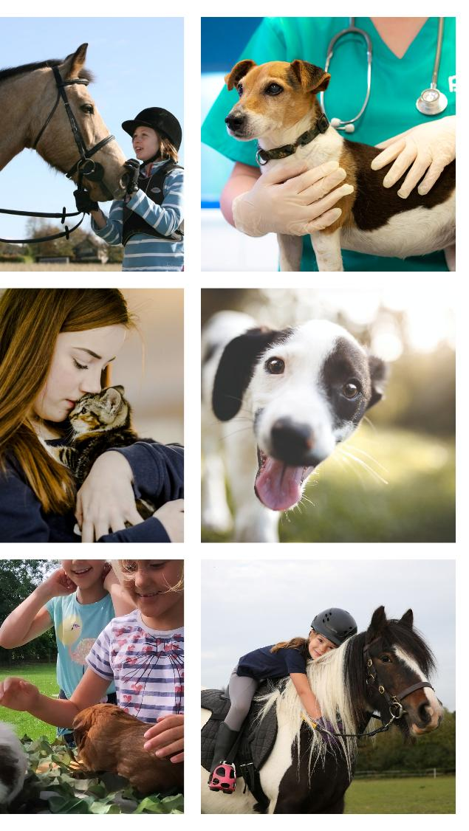
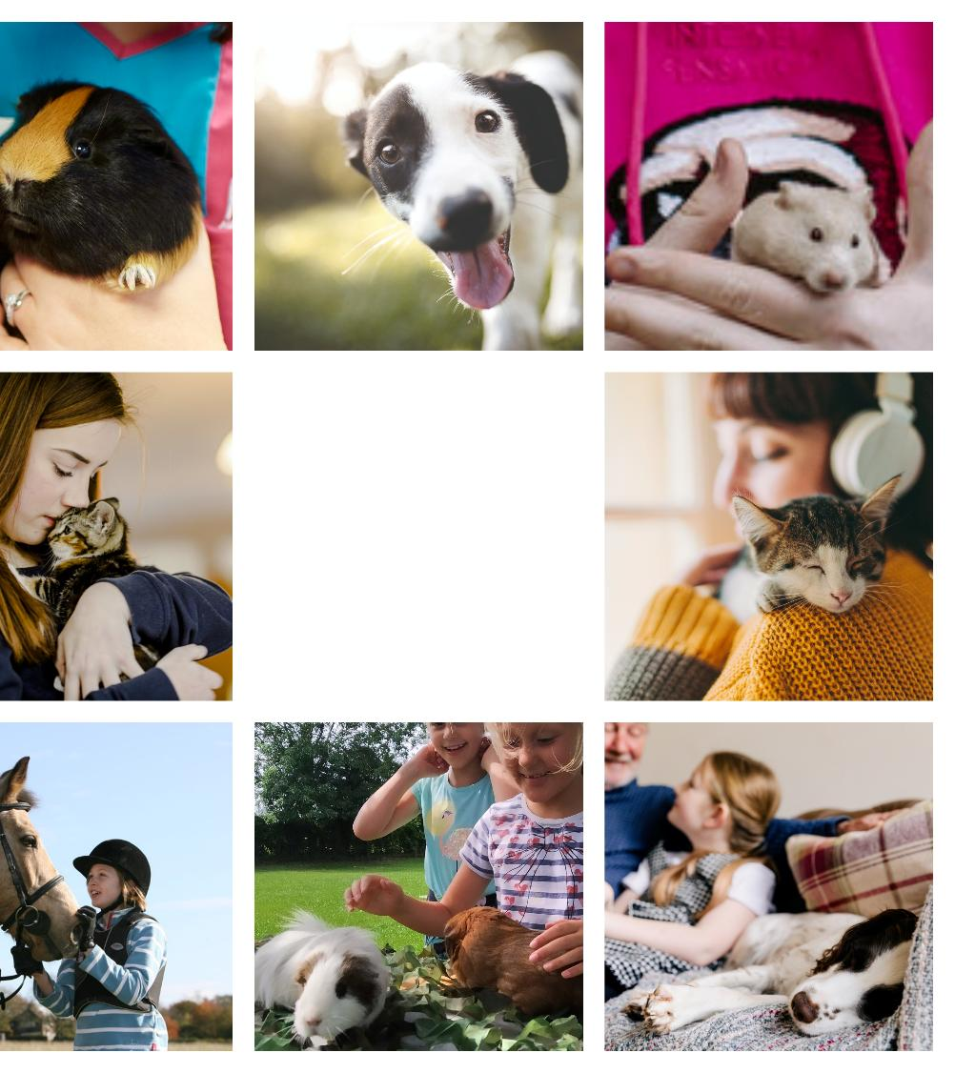
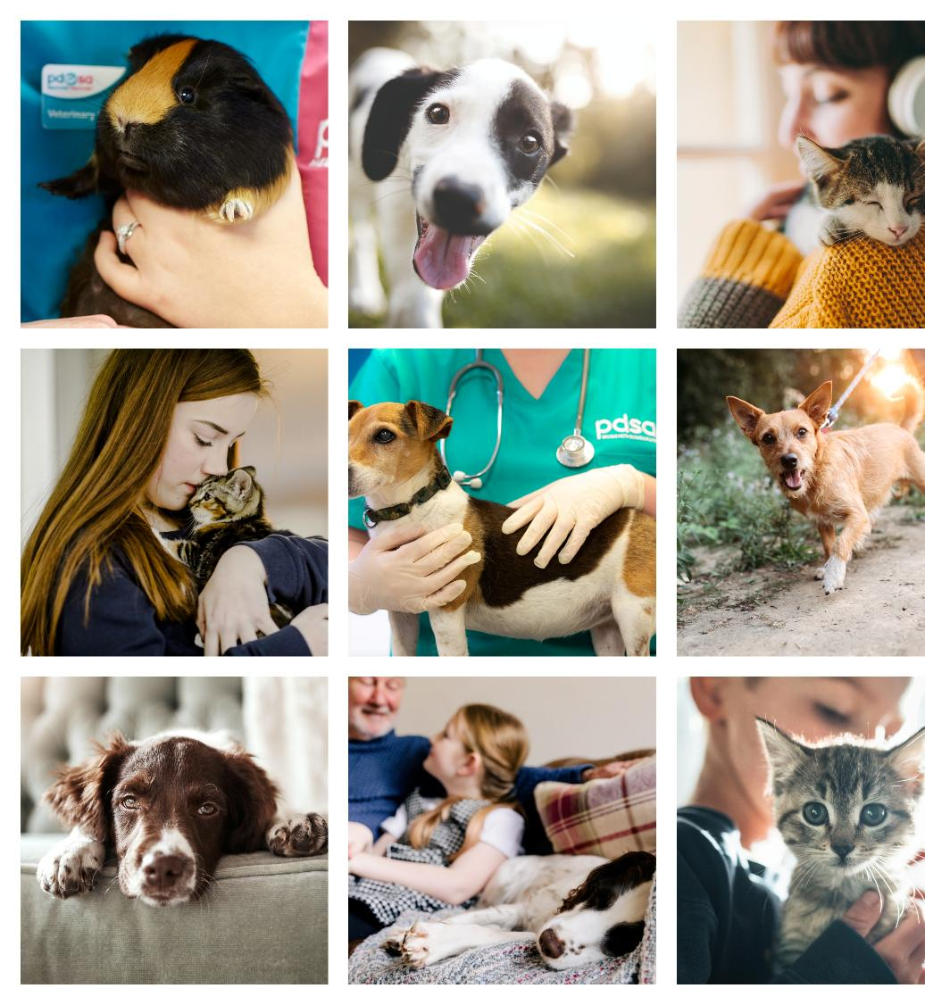
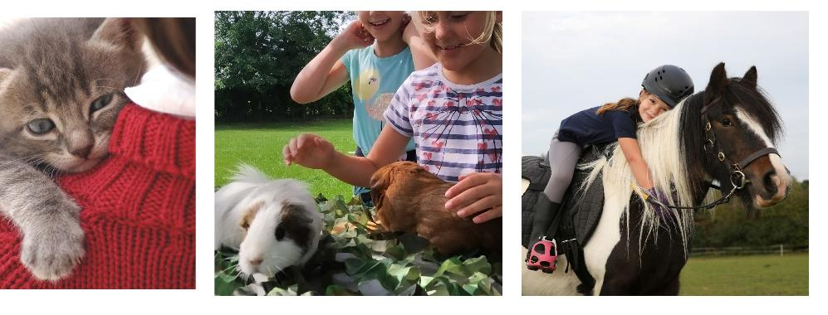
Meet the Pet Education Partnership!
A unique collaboration of eight leading animal welfare charities across the UK, all working together to improve pet wellbeing through education.
Notes:
Presenter Notes:
Explain about the Pet Education Partnership (as a thank you for supplying the slides).
This could just be that the partnership believe that every child in the UK should have access to animal welfare education so they can be the best pet owners, vets and vet nurses in the future.

Slide 4
What we will cover today…
1
2
3
How we can help our pets to be happy and healthy
How we can help make the world a better place for people, animals and the environment’
What animals need to be happy and healthy
Notes:
Presenter Notes:
Read out the objectives from the slide

Slide 5

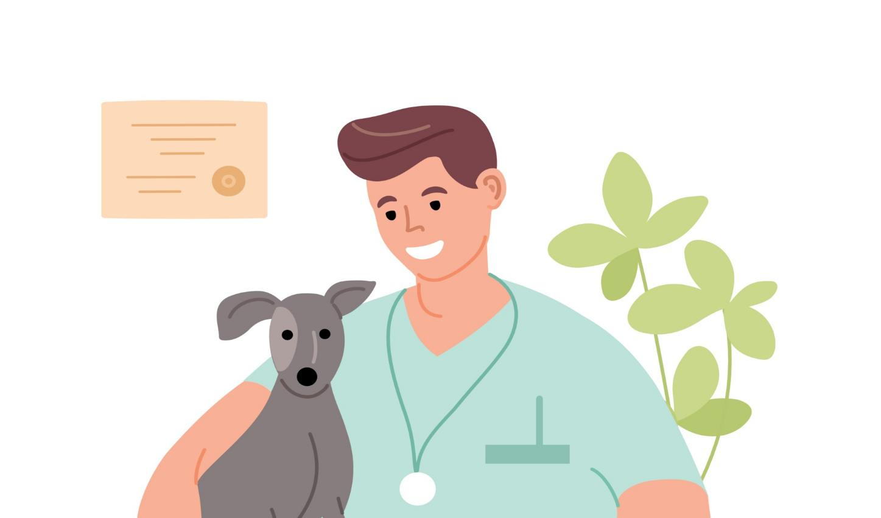
What do we need to be happy and healthy?
Notes:
Presenter Notes:
Ask learners to discuss what humans need to be happy and healthy. Answers can be given verbally (using ‘hands up’) or learners could spend a couple of minutes writing down their ideas or discussing them with their partners/in small groups first before feeding back to the class.

Slide 6
friends
water
What do we need to be happy and healthy?
choice
toys
sleep
being clean
love
a safe home
family
exercise
balanced diet
pets
mental wellbeing
fun
hobbies
being outdoors
Notes:
Presenter Notes:
Once learners have given their answers, present this slide and use it to reiterate the key themes learners have hopefully already suggested (i.e., friends, family, a healthy diet, exercise, wellbeing, etc…)

Slide 7


What do animals need to be happy and healthy?
Notes:
Presenter Notes:
Now that leaners have thought about what humans need to be happy and healthy, ask them to consider what animals might need to be happy and healthy?
As before, learners can do this in a number of different ways, such as ‘hands up’, using mini whiteboards/paper to write down their ideas, discussing in pairs/small groups, etc…

Slide 8
companionship
love
family
water
What do animals need to be happy and healthy?
sleep
balanced diet
being clean
choice
a safe home
toys
exercise
mental wellbeing
fun
being outdoors
Notes:
Presenter Notes:
Again, once learners have given their answers, present this slide and use it to reiterate the key themes learners have hopefully already suggested (i.e., family, a healthy diet, exercise, fun, enrichment, a safe home, companionship , etc…)
Point out the things pets need that leaners perhaps haven’t mention (this might be concepts like choice) and explain why they are important (i.e., like us, all pets like to have choice and we should look for opportunities to give them this where we can).

Slide 9



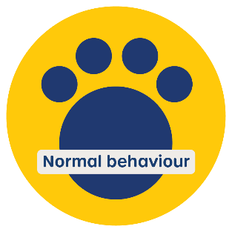
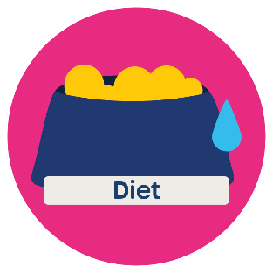

What all animals need to live their best lives!
Notes:
***Depending on how confident you feel at presenting detail around the welfare needs, you can either use this slide (slide 9), with minimal detail on slide, or, instead, opt to use slide 10, which provides more detail on slide around each of the freedoms. This is up to the discretion of the presenter.
Presenter Notes:
Now the class have considered what pets need, briefly talk through each of the key needs (i.e., what all animals need to be happy and healthy, or to live their best lives). Here, you may want to provide some examples of what that might look like for different species (i.e., what a home for a hamster might look like, compared to a home for a horse or a dog, how dogs and cats may be content living with humans and no other pets, whereas guinea pigs and rabbits need to live in pairs).
At the Pet Education Partnership, we include Mental State as an addition to the 5 Welfare Needs and explain that all 5 needs lead to a positive mental state (i.e. living their best lives).
Here is our agreed terminology for each need (also on the next slide):
Diet - Animals need the right amount of healthy and suitable food, and access to fresh, clean water at all times.
Home (Environment) - Animals need a safe, comfortable, and suitable place to live.
Health - Animals need protection from pain, harm and suffering, with the right help from people when needed.
Company (Companionship) - Some animals like to live with friends, but others prefer space to live on their own.
Normal Behaviour (Environment) - Animals need the opportunity to behave in ways that are natural to them, and to have choices about when and where to do that.
Mental State - Animals need safe and positive experiences in order to live their best life and feel happy

Slide 10

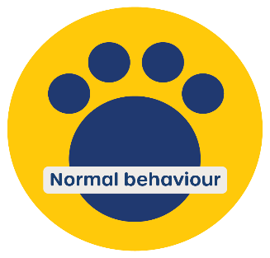
Protection from pain, harm and suffering, with the right help from people when needed.
Some animals like to live with friends, others prefer space to live on their own.
A safe, comfortable, and suitable place to live.
A safe, positive experiences in order to live their best life.
What all animals need to live their best lives!
The right amount of healthy and suitable food, and access to fresh clean water at all times.
The opportunity to behave in ways that are natural to them, and to have choices about when and where to do that.
Notes:
Presenter Notes:
This slide can be used to give more detail on each of the 6 needs or can be used instead of the previous slide should the presenter want more detail on each of the needs visible.
If the presenter can give this detail verbally, without text being on screen, this slide can be hidden. You can hide a slide by right clicking on the slide in the left hand column and selecting ‘Hide Slide’.
We have included the definitions in the notes of the previous slide in case you want to hide this slide.

Slide 11
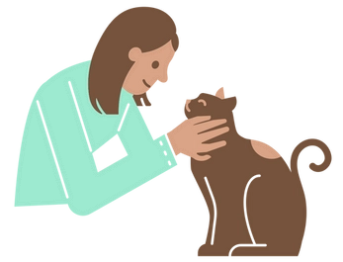
…let’s look at how we can help them too!
Now we know what animals need to be happy, healthy, and live their best lives…
Notes:
Presenter Notes:
Use this slide to help learners recognise the link between the previous discussions around animal needs and the next task. Learners have currently considered what the needs of all animal are, now they will complete a task that helps them to think about how we can help our pets to have their needs met. This will be done by thinking about life as a vet and how they can help owners meet their pets need.
Image: https://www.freeimages.com/clipart/feline-vet-person-png-art-5695274 (File ID#5695274)

Slide 12

For the next task you will pretend to be Vets and Vet Nurses…But what does life in my vet surgery looks like?
Add your own photos to this slide
Notes:
Presenter Notes:
This slide is an opportunity to share some images of yourself/your veterinary practice to help the children see where you work and bring the next activity to life. Ask the children to imagine they are working there and are now vets/vet nurses themselves. Additionally, if you have brought in props to show them (i.e., uniform, a stethoscope, thermometer, toenail clippers, gloves, etc…) now can be a good time to share these with the class or ask some members of the class to dress up as vets in preparation for the task.
Should you not want to use this slide, the slide can simply be skipped/hidden.
Image: https://www.freeimages.com/clipart/feline-vet-person-png-art-5695274 (File ID#5695274)

Slide 13
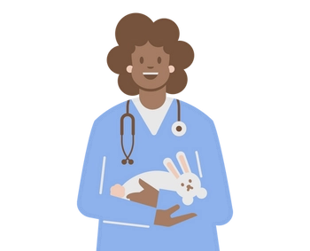
A Vet's job is to help animals live their happiest, healthiest lives.
Let’s look at what a day at the vets looks like.
For each patient, decide:
- Which of the pet’s needs are not being met?
- What change could we make to help that pet live a better
life?
Notes:
Presenter Notes:
Now children have seen what life in a vet surgery looks like on the previous slide introduce the task.
Remind the class that a Vet/Vet Nurses’ job is to help all pets have their needs met so they can live their happiest, healthiest lives.
For the main task, learners will pretend to be Vets/Vet Nurses for a day by working through a number of different appointments. For each appointment, learners should read the key information about the pet, decide what need is not being met and think about what changes could be made to help meet that need.
Image: https://www.freeimages.com/clipart/vet-bunny-people-png-design-5692141 (File ID#5692141)

Slide 14





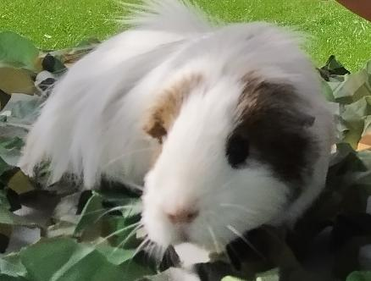


Appointment 1.
Pet: Guinea Pig
Name: Pebbles
Age: 2
Home: Live in a small hutch on their own.
Problem: Not eating,
sleeping a lot, acting
nervous.
Which of the pet’s needs are not being met?
What change could we make to help that pet live a better life?
Notes:
Presenter Notes:
The presenter (or learners, depending on their age/reading level) should read out the information to the class.
Once read through, remind learners of the questions they are seeking to answer (these are displayed in yellow box).
Based on both the profile and the questions, guide the learners to think about the answer to both questions. For question 1 (which needs are not being met, learners can use the welfare needs icons as a reminder of the 6 welfare needs).
Answers:
1. Which of the pet’s needs are not being met?
As the guinea pigs' hutch is too small, and they are living on their own, they may be bored, lonely and frustrated. Guinea pigs are a social species, so Pebbles’ problem behaviour (i.e. not eating, oversleeping, being nervous) may be because she is lonely and under stimulated. In this case, the need for ‘company’ and ‘home’ are not being met.
2. What change could we make to help that pet live a better life?
By adopting a second guinea pig the family could ensure Pebbles is happier and more content, meeting their need for ‘company’. However, they would also need to consider acquiring a larger hutch and a run (if they do not have one already) to provide more space for the guinea pigs to exercise, explore and interact with their environment, like they would in their natural habitat.

Slide 15

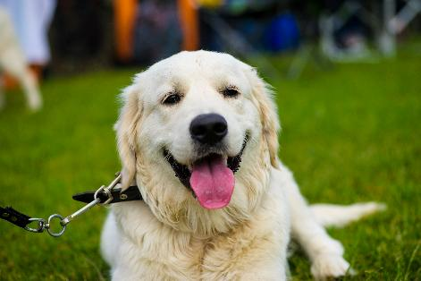
Appointment 2.
Pet: Dog
Name: Gordon
Age: 6
Home: Live in a top floor flat.
Problem: Chewing furniture and shoes, lots of barking and whining, and cannot sit still.
Which of the pet’s needs are not being met?
What change could we make to help that pet live a better life?
Notes:
Presenter Notes:
The presenter (or learners, depending on their age/reading level) should read out the information to the class.
Once read through, remind learners of the questions they are seeking to answer (these are displayed in yellow box).
Based on both the profile and the questions, guide the learners to think about the answer to both questions. For question 1 (which needs are not being met, learners can use the welfare needs icons as a reminder of the 6 welfare needs).
Answers:
1. Which of the pet’s needs are not being met?
Living in a top floor flat (likely with less space and less access to outdoor space) Gordon may be feeling frustrated. Chewing furniture/shoes, excessive barking/whining and restlessness are also signs that the dogs need for a satisfied ‘mental state’ is not being met. The dog is likely under stimulated.
2. What change could we make to help that pet live a better life?
Ensuring the dog has lots of access to outdoor space (i.e., more walks/time outside), and by providing the dog with lots of opportunities for mental stimulation/enrichment may improve the dog's behaviour. Mental enrichment/stimulation for dogs could be achieve by giving extra outdoor time, time to sniff, puzzle toys, opportunities for play, scent games, attention, etc…

Slide 16

Appointment 3.
Pet: Hamster
Name: Blondie
Age: 1
Home: Live in small empty cage.
Problem: Sleeping more than usual, biting the bars, excessive grooming and overeating.
Which of the pet’s needs are not being met?
What change could we make to help that pet live a better life?
Notes:
Presenter Notes:
The presenter (or learners, depending on their age/reading level) should read out the information to the class.
Once read through, remind learners of the questions they are seeking to answer (these are displayed in yellow box).
Based on both the profile and the questions, guide the learners to think about the answer to both questions. For question 1 (which needs are not being met, learners can use the welfare needs icons as a reminder of the 6 welfare needs).
Answers:
1. Which of the pet’s needs are not being met?
Living in small empty cage likely means the hamsters need for a suitable ‘home’ is not being met. When a hamster is bored or under stimulated by their home they may be more likely to display behaviours such as more sleeping, biting the bars, excessing grooming and overeating.
2. What change could we make to help that pet live a better life?
To meet Blondie’s need for a suitable ‘home’ her owner should ensure she has a spacious and exciting cage to play in and explore. Her cage could be more spacious, with suitable bedding material and spaces to burrow and nest, such as tubes, boxes or areas with deep bedding. Her cage should also include food, fresh water, and lots of toys to keep them active and engaged. Toys might include plastic wheels, chew sticks, tunnels, climbing structures, etc…

Slide 17
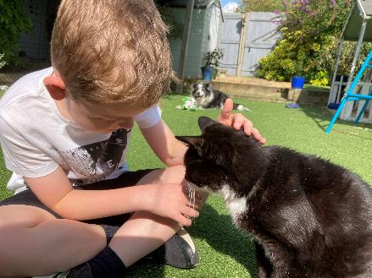
Appointment 4.
Pet: Cat
Name: Whiskers
Age: 13
Home: Live in four-bedroom house with a large garden.
Problem: Excessive scratching, biting at fur and hair loss.
Which of the pet’s needs are not being met?
What change could we make to help that pet live a better life?
Notes:
Presenter Notes:
The presenter (or learners, depending on their age/reading level) should read out the information to the class.
Once read through, remind learners of the questions they are seeking to answer (these are displayed in yellow box).
Based on both the profile and the questions, guide the learners to think about the answer to both questions. For question 1 (which needs are not being met, learners can use the welfare needs icons as a reminder of the 6 welfare needs).
Answers:
1. Which of the pet’s needs are not being met?
Whiskers’ excessive scratching, biting at fur and hair loss likely indicates she is in poor health. It is likely that she may have fleas meaning her need for ‘health’ is not currently being met.
2. What change could we make to help that pet live a better life?
Ensuring all cats, and other pets, have access to suitable health care, such as flea and worming treatments, and regular visits to the vets means their pet is more likely to be healthy and happy, and that vets are more able to spot any health issues earlier on. By doing so, these health issues can be dealt with quickly meaning the cat is no longer feeling discomfort and can live their best life.

Slide 18
So remember…
Here are some keyways you can make a difference to your pets:
Some pets benefit from company!
Pets need spacious, enriching environments that meet their needs!
Pets need enrichment!
Pets need regular medication and health checks!
Notes:
Presenter Notes:
Use this slide to remind learners of the key learning points from this task. Further detail, such as that below, can be given.
Pets benefit from company! Some pets enjoy company. Dogs are social creatures who enjoy sharing their lives with humans and, some pets, like rabbits and guinea pigs’ ideally need to live in pairs in order to live their best lives.
Pets need suitable environments to live in! It is important that all pets have safe spaces to sleep, rest, and take time out. Pets, particularly pats like hamsters, guinea pigs and rabbits, also need environments that are big enough for them to be enriching, and give opportunities to burrow, explore and exercise.
Pet need enrichment! All pets need opportunities to have fun and engage them physically and mentally. Dogs and cats need opportunities to play and explore outside where they can sniff, hunt and display their natural behaviours. Pets like hamsters, rabbits and guinea pigs need hutches and cages which include items that can help them exercise, burrow and play.
Pets need regular medication and health checks! Health care is important for all pets. For cats and dogs, regular medication, like flea and worming treatment, is important and all pets benefit from regular vet check-ups to ensure they are happy and healthy.

Slide 19
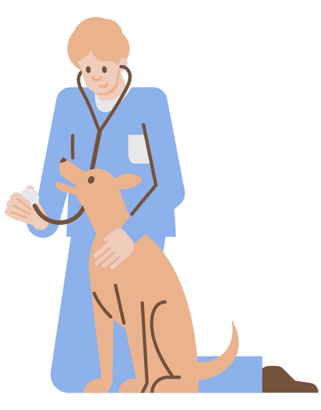
Now we know some ways to
help keep
animals happy
and healthy…
…let’s learn about how Vet Sustain help our planet, and the animals living on it, to be happy and healthy too!

Slide 20

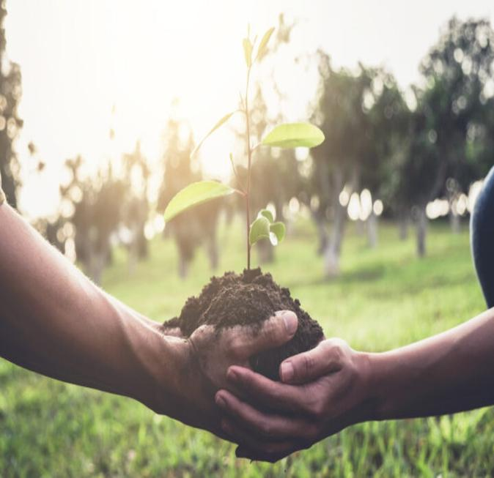
Their Mission
To help
veterinary workers to improve the health and wellbeing of animals, people and the environment.
Notes:
Presenter Notes:
Introduce Vet Sustain and their mission using the text on slide. More detail can be added verbally if desired.

Slide 21
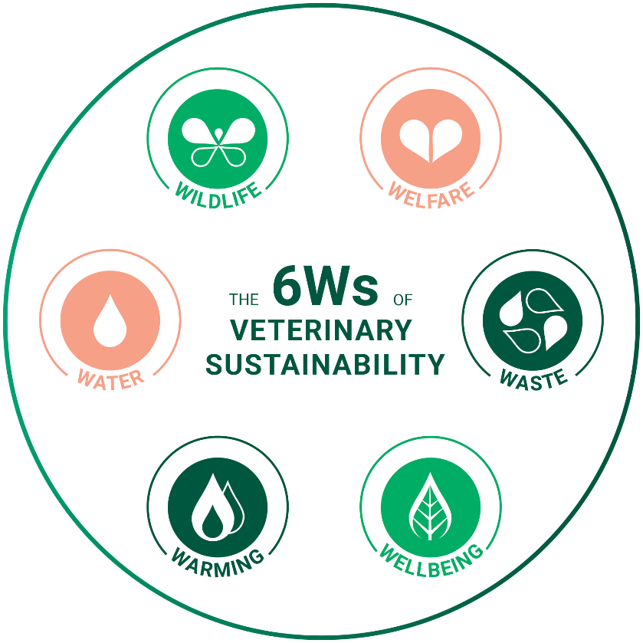
They live out their mission by working to achieve these six goals…
Notes:
Presenter Notes:
Explain that, in order to live out their mission, Vet Sustain have created the 6Ws of veterinary sustainability as a framework to encourage sustainable change.
Next, talk through each of the 6Ws, explaining what they are and perhaps giving examples of how they might be tackled. (See details below)
1. WILDLIFE - Diverse and abundant wildlife: Conserve and enhance natural landscapes, habitats and biological diversity and abundance of wild terrestrial and aquatic plant and animal species.
2. WELFARE: A good life for animals: Safeguard and advocate for the health and welfare, in life and at the point of death, of animals under our care and those that are affected by human activity.
3. WELLBEING - Health and wellbeing: Safeguard and enhance the physical and mental wellbeing of people and support a transition to livelihoods and lifestyles that are fit for the future.
4. WASTE - A no-waste society: Minimise the usage and disposal of resources and materials, and support a transition to a circular economy.
5. WATER - Enough clean water for all: Uphold best practice in fresh water conservation and protection to mitigate water stress and prevent water pollution.
6. WARMING - Net zero warming: Implement and promote decarbonisation through energy efficiency, the generation and use of renewable energy, mitigation of global warming and sequestration of carbon.

Slide 22
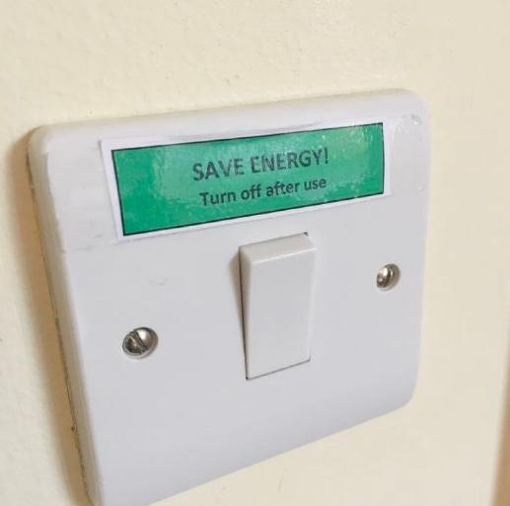


Case study: Ark Veterinary Surgery
Here’s how one vet practice uses the 6Ws to make improve the health and wellbeing of animals, people and the environment…
Ark are a great example of how Vet Sustain supports vets in caring for both the environment and the natural world!
Reminders to turn off switches whilst not in use to reduce electricity usage
Use of water
distillers instead of single use plastic bottles
Notes:
Presenter Notes:
Use this slide, and the following slide to provide learners with a straightforward example of how Vet Sustain help vet practices to be more sustainable. The example of Ark Veterinary surgery has been used as they provide lots of simple, child friendly, examples of how a veterinary practice can make a positive difference to the planet.
For the two case study slides talk through each of the text bubbles to explain just some of the ways Ark worked to be a more sustainable vet surgery. This case study also helps children to think about practical ways they too can be more environmentally friendly too (i.e., turning of light switches when they leave the room, not using one use plastic bottles, planting flowers, recycling more, etc…).
Source: https://vetsustain.org/work/case-study-ark-veterinary-surgery

Slide 23
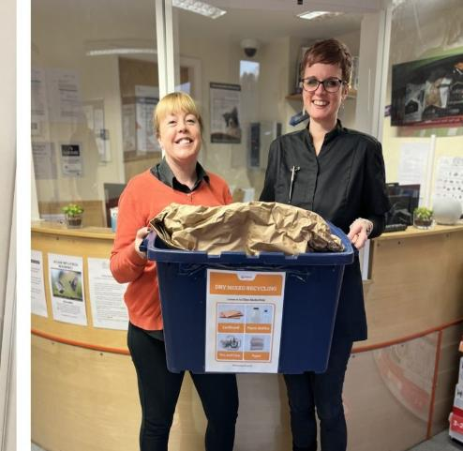
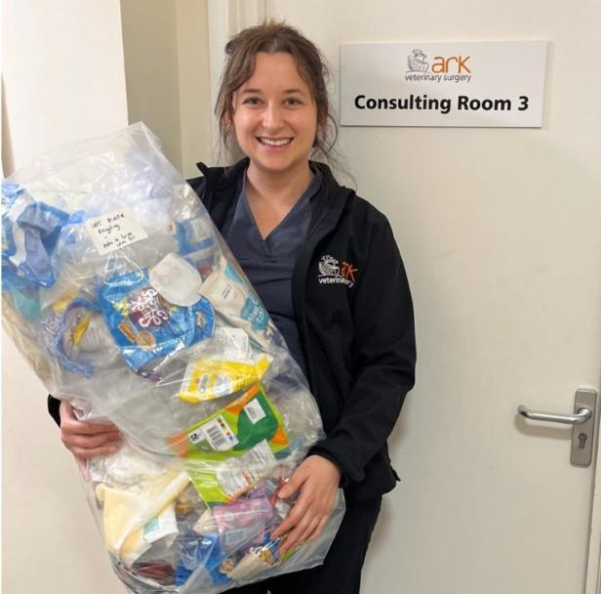

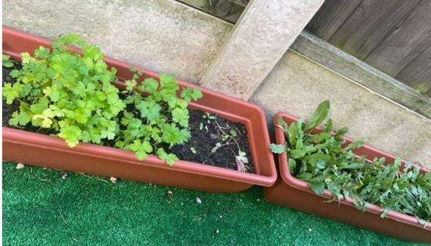

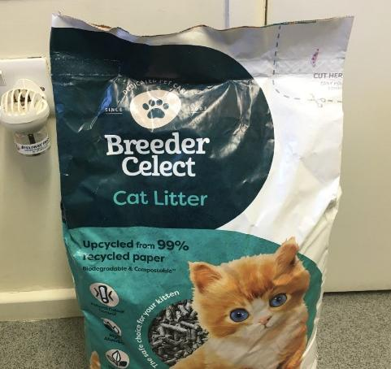
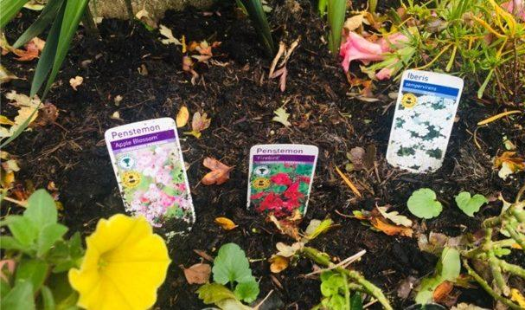

Creation of bee friendly gardens to grow fresh herbs for patients and flowers to attract bees and other wildlife
Greater recycling opportunities
Switching to more environmentally friendly cat
litter

Slide 24


Here’s how my practice use the 6Ws to make positive change!
Like the example on the previous two slides, feel free to insert information and images of your own practice and provide examples of how you use the 6Ws!
Notes:
Presenter Notes:
Optional change:
Here, you can create a slide or two to demonstrate how your vet practise use the 6Ws to make a positive change! If preferred, so you are not giving two similar case studies, you may choose to use your example of how you use the 6Ws and delete/hide the previous case study (i.e., slide 22 and 23).
On this slide, like one slides 22 and 23, you might want to add text and images to demonstrate how you use the 6Ws. The icons have been left on screen in case useful. These can be used to make it clear which of the 6Ws are being used/targeted.

Slide 25


Let’s look at how we can use the 6Ws and make the world a healthier and happier place for both humans and animals.
Can you think of any ways you can follow the 6Ws?
Notes:
Presenter Notes:
Now learners know more about the work of Vet Sustain, and have seen a case study of the 6Ws in action, ask learners to think about how they can make a positive difference to pets and the planet too!
Ask learners to think about different ways they can follow the 6Ws to improve the lives of their pets and the planet. They may want to discuss ideas as a whole class, in small groups or even in pairs. Once they have discussed, ask them to share their ideas with the class! (see next slide for examples of what they might say/what you could guide them towards discussing if they are stuck).

Slide 26
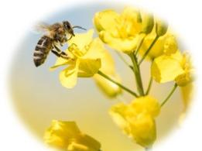
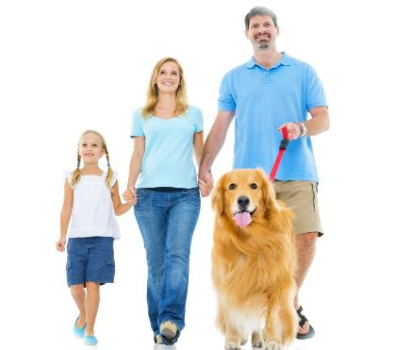
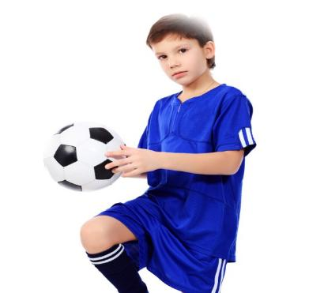
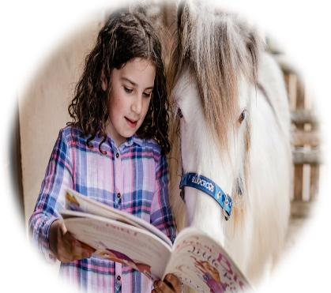
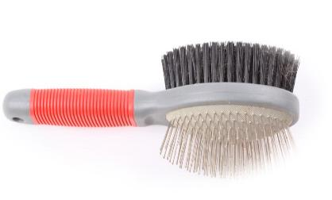

Plant bee-friendly flowers
Take your dog for a walk
Play outside
Read or talk to your pet
Remind your grown-ups to pick up dog poo
Brush your pet
Notes:
Presenter Notes:
Examples of how learners can follow out the 6Ws:
1. WILDLIFE:
Keep dogs on a lead near wildlife (like ducks, squirrels or sheep) so they don’t scare or harm them.
Reminding grown-ups to pick up dog poo to stop it from harming plants or animals in parks and nature areas.
Stay on paths during walks to protect wildflowers and homes of small animals.
Plant bee-friendly flowers or a small herb garden in pots for pollinators.
Fill a shallow dish with water for birds and bugs on hot days (away from where your pets can knock it over).
2. WELFARE:
Brush and feed your pet gently each day with adult help—pets need love and care.
Make a cozy sleeping area for your rabbit, guinea pig, or hamster using safe, reused materials.
Speak up if you see someone being unkind to animals, even if it’s just teasing.
Be 'treat-wise' – don’t give too many treats to dogs or cats, even if they beg. It keeps them healthy!
Give your pet quiet time if they’re resting—animals need breaks too.
Make a fun toy or treat puzzle for your rabbit or hamster using old cardboard. When pets get to enjoy these toys or puzzles, it can enrich their lives making, making them happier and improving their welfare.
3. WELLBEING:
Take your dog for a walk with an adult—good for both of you!
Read or talk to your pet—it’s calming and helps you feel close to them.
Make a fun toy or treat puzzle for your rabbit or hamster using old cardboard, not only is crafting fun and often relaxing for us, but it can improve the wellbeing of our pets when they get to enjoy it too!
Play outside instead of screen time—it’s better for your mood and the environment.
Help with pet care (with a grownup) like changing water or tidying their bedding—responsibility builds confidence.
4. WASTE:
Reuse boxes or tubes to build a play tunnel for small pets like guinea pigs or hamsters.
Use old T-shirts or towels as pet bedding instead of throwing them away.
Make homemade pet toys from safe recycled items (e.g., sock knots for dogs, cardboard balls for cats).
Recycle food containers and packaging after feeding your pet.
Only take what you need—don’t waste food, water, or paper.
5. WATER:
Turn off the tap while brushing your teeth.
Help fill your pet’s water bowl carefully to avoid spills and waste.
Use leftover clean water from water bottles or cups to water plants.
Tell an adult if a tap is leaking—saving water helps everyone.
6. WARMING:
Turn off lights when you leave a room.
Walk your dog to the park (with a grownup) instead of going in the car when it’s close by.
Use a jumper or blanket if it’s chilly instead of turning up the thermostat.
Help dry pet towels on a clotheslines or airers instead of using a tumble dryer.

Slide 27






Match each example to the correct W!
Turn off lights when you leave a room.
Make a fun toy or treat puzzle for your pet – it’s fun for them (and can also be fun and relaxing for us!)
Turn off the tap while brushing your teeth.
Reuse boxes or tubes to build a play tunnel for small pets like guinea pigs or hamsters.
Give your pet quiet time if they’re resting.
Keep dogs on a lead near wildlife.
Notes:
Presenter Notes:
Optional Activity:
Read out each statement and ask learners to vote on which W the statement matches with. Following their guess, use the animation (animated arrow) to reveal the answer.
When learners have gone through all 6 examples, remind them that these ideas, as well as the ideas on the previous slide, will help them with the following task (i.e., creating their Pet Planet Promise). Learners may want to use these ideas to create their final promise.
Note: Use information in the note section of slide 26 to offer further detail around how each of the points above links to the relevant W

Slide 28
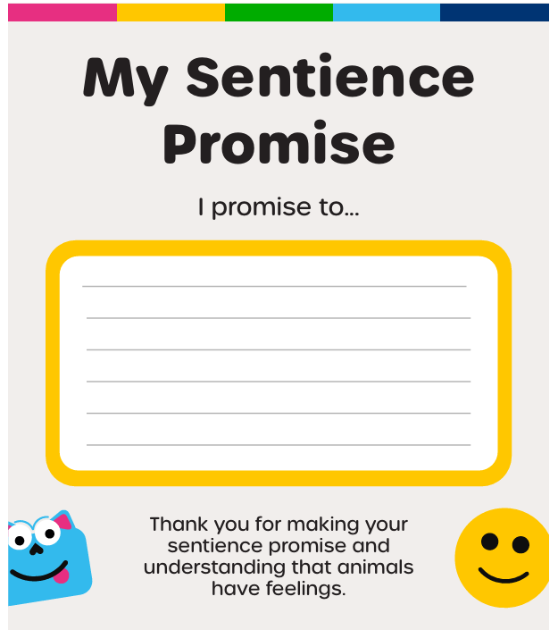
Your Pet Planet Promise!
My Pet Planet Promise
Now you have heard lots of different ways that we can help the pets and the planet to be happier and heather, you can make a Pet Planet Promise!
Thank you for making your Pet Planet Promise and helping the world be a happier, healthier place!
Notes:
Presenter Notes:
Now learners know more about how to follow the 6Ws and be more sustainable they will make their own Pet Planet Promise. Encourage learners to think carefully about what they can realistically do at home to make a difference to the planet or the amazing pets their share their lives with!
Once complete, ask some learners to share their promises (if they want to) and encourage them to share these with their families when they get home. This is a great way to encourage them to carry out their promises!
This can be done on the provided worksheet template or simply in their books or on their mini whiteboards.

Slide 29

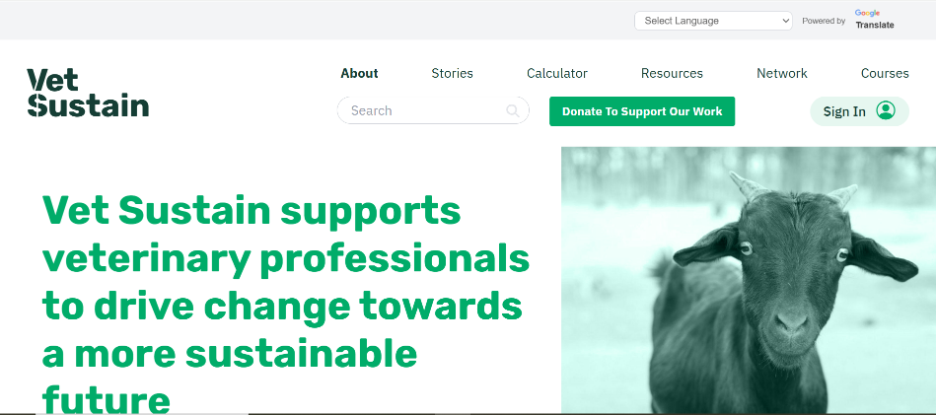
Want to know more?
Visit our webpages to find out more!
www.peteducationpartnership.org
www.vetsustain.org
Notes:
Presenter Notes:
The session is now concluded. Thank the learners for their participation and the amazing promises they have made!
Remind the learners, and teachers that if they want to know more about PEP (i.e., their resources and live events for children), or the work of Vet Sustain they can visit our webpages.

Slide 30



Thank you
Thank you

